Slide 1
Model Selection
For a set of p-1 predictors, there are 2^{p-1} possible regression models that can be constructed, based on the fact that each predictor can be either included or excluded from a particular model.
For example, if there are 4 predictors, then there are 16 different possible models.
There is one model with no predictors, four models with just one predictor, six models with two predictors, four models with three predictors, and one model with all four predictors.
In several cases, it is not possible to make detailed examinations of all possible models.

Slide 2
Model Selection
For example, if there are 10 predictors, then there are 1,024 possible models.
Even though software makes it possible to run all possible models without too much time, it would not be possible to carefully examine each of these models.
Model selection procedures have been developed to identify a small group a regression models that are good based on a specific criterion.
Then a detailed examination can be made of this smaller subset of models hopefully leading to the selection of a model.

Slide 3
Model Selection
We denote the number of potential predictor variables in a pool by P-1, and assume all models contain an intercept.
Thus a model with all predictors in it has P parameters and a model with no predictors has 1 parameter.
The number of predictors in a subset model is still denoted by p-1 so that there are p parameters in that model.
We also assume that the number of observations exceeds the number of potential parameters, n > P. A rule of thumb is to have at least 6-10 observations for every potential predictor.

Slide 4
Model Selection
One criterion for comparing regression models is the R_{p}² criterion.
The R_{p}² criterion identifies good models by finding subsets of predictors for which the coefficient of multiple determination R² is large.
We denote the number of parameters in a model by the subscript on R², thus R₃² has 3 parameters (the intercept and 2 predictors).

Slide 5
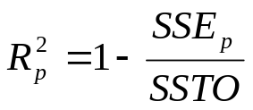
Model Selection
Using the R_{p}² criterion is the same as using the error sum of squares SSE_{p} as the criterion.
With the SSE_{p} criterion, models with small SSE_{p} are considered good.
Recall, that
Since the denominator SSTO is the same for any subset model, when SSE_{p} is small then R_{p}² is large.

Slide 6
Model Selection
The point of the R_{p}² criterion is not to find the subsets that maximize R².
We know that R² is nondecreasing as new variables are added to the model, thus it will be at a maximum when all P-1 potential predictors are in the model.
The R_{p}² criterion is used to find the point where adding more predictor variables is not worthwhile because it leads to just a small increase in R².
We will consider an example where survival time of hospital patients (Y) has 4 potential predictors, X₁,…,X₄.

Slide 7
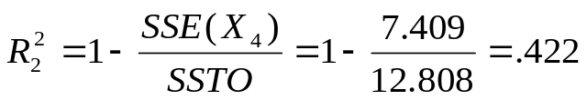
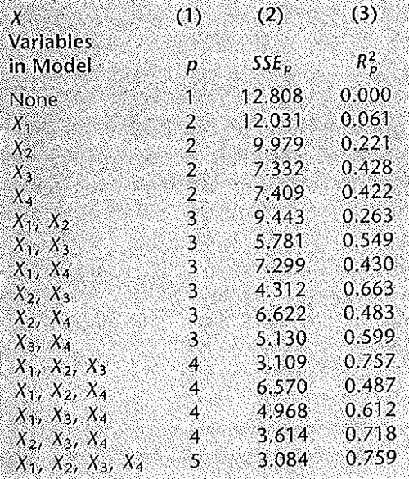
Model Selection
The table below shows the SSE_{p} and R_{p}² for all the possible combinations of the 4 predictors. For example, when X₄ is the only variable in the model, we have
And note that SSTO corresponds to the SSE when no predictors are in the model, SSE₁.

Slide 8
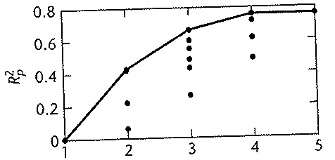
Model Selection
Below is a plot of R_{p}² against p. The maximum value of R_{p}² for each level of p, denoted by max(R_{p}²) are connected by a solid line.
It is clear that there is little increase in R_{p}² after 3 variables are included in the model (p=4). So it makes sense to look further at the models with 3 variables, especially the two with the highest R_{p}² values.

Slide 9
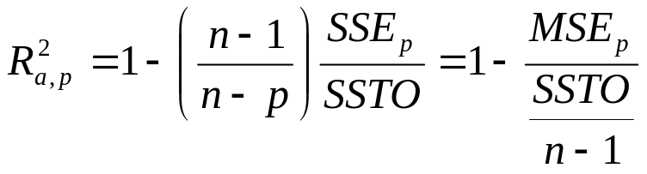
Model Selection
Since R_{p}² does not take into account the number of parameters in the model, the adjusted coefficient of multiple determination R_{a,p}² is often used as a criterion.
This coefficient takes the number of parameters into account through the degrees of freedom.
Note that R_{a,p}² increases if and only if MSE_{p} decreases since SSTO/n-1 is fixed for a given set of data.

Slide 10
Model Selection
When p gets larger, the degrees of freedom n-p gets smaller, thus MSE_{p} gets larger.
Therefore, MSE_{p} can only decrease if the decrease in SSE_{p} is large enough to offset this increase due to fewer degrees of freedom.
The largest R_{a,p}² for a value of p, max(R_{a,p}²), can decrease as the number of parameters in the model increases. Again, this is not the case for max(R_{p}²).
Similar to R_{p}² , we use R_{a,p}² to find the point where adding more predictor variables is not worthwhile.

Slide 11
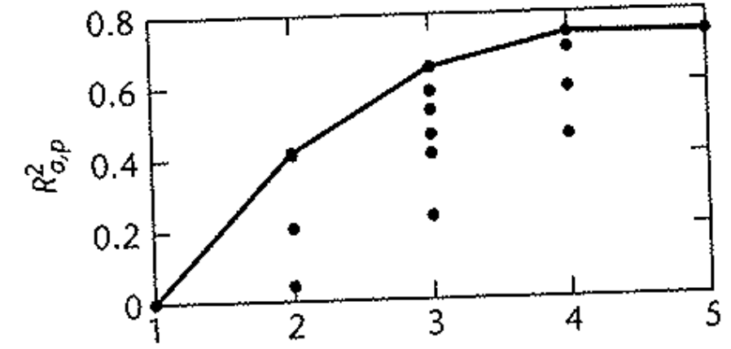
Model Selection
Below is a plot of R_{a,p}² against p, the number of parameters in the model. Again, it is clear that there is little increase in R_{a,p}² after 3 variables are included in the model. So it makes sense to look further at the models with 3 variables, especially the two with the highest R_{a,p}² values.

Slide 12
Model Selection
The Akaike’ information Criterion (AIC) and the Schwarz’ Bayesian Criterion (SBC) are two other model selection criteria that penalize for adding predictors.
Note, the SBC is also known as the Bayesian Information Criterion (BIC).
We search for models with small values of AIC or SBC, which are defined as
AIC_{p} = n ln(SSE_{p}) – n ln(n) + 2p
SBC_{p} = n ln(SSE_{p}) – n ln(n) + [ln(n)]p
Notice, that for both of these measures, the first term is n ln(SSE_{p}) which decreases as p increases.

Slide 13
Model Selection
For a given sample, the second term in both measures, n ln(n), is fixed regardless of which model is used.
For both measures, the third terms, 2p and [ln(n)]p, are penalty terms which increase as the number of predictors increases.
When a predictor is added, the criteria will only be smaller when the decrease in the SSE outweighs the increase in the penalty terms.
For n ≥ 8, the penalty term for SBC is greater than that for AIC.

Slide 14
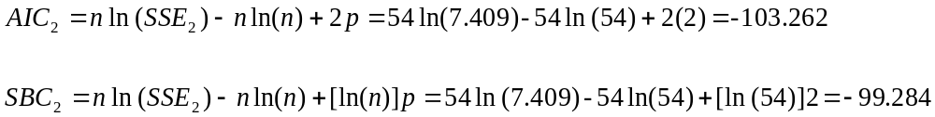
Model Selection
For instance, when X₄ is the only predictor, we have
Smaller is better, so the AIC criteria does better than the SBC criteria, which is the case since n=54>8.

Slide 15
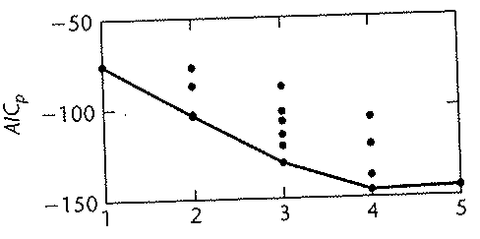
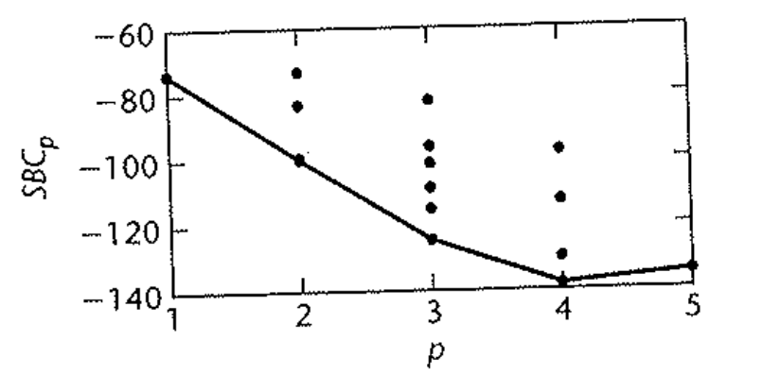
Model Selection
Below are the AIC_{p} and the SBC_{p} values for all possible regression models plotted against p. Both of these criteria are minimized for subset (X₁,X₂,X₃)

Slide 16
Model Selection
The prediction sum of squares (PRESS) criterion is a measure of how well the use of the fitted values for a subset model can predict the observed responses Y_{i}
The PRESS differs from the error sum of squares SSE in that each fitted value is obtained by deleting the i^{th} case from the data set, estimating the regression function from the remaining n-1 cases, and then using the fitted regression function to obtain the predicted value Y(hat)_{i,(i)}
The notation Y(hat)_{i,(i)} is used to indicate that this is the predicted value for the i^{th} case by the first subscript i and that the i^{th} case was omitted when the regression function was fitted by the second subscript (i).

Slide 17

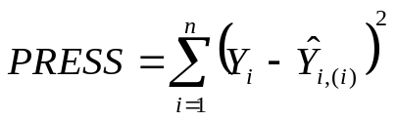
Model Selection
The PRESS prediction error for the i^{th} case is
The PRESS criterion is the sum of the squared prediction errors over all cases
Models with small PRESS values are considered good candidate models because they indicate small prediction errors. That is when the prediction errors are small, so will be the sum of the squared prediction errors.
Thus, models with small PRESS values fit well in the sense of having small prediction errors.

Slide 18
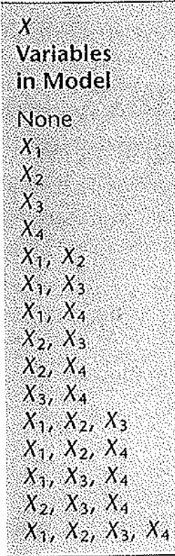
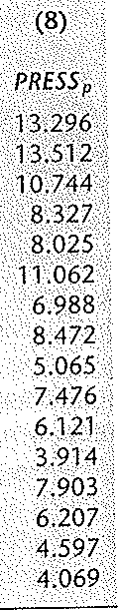
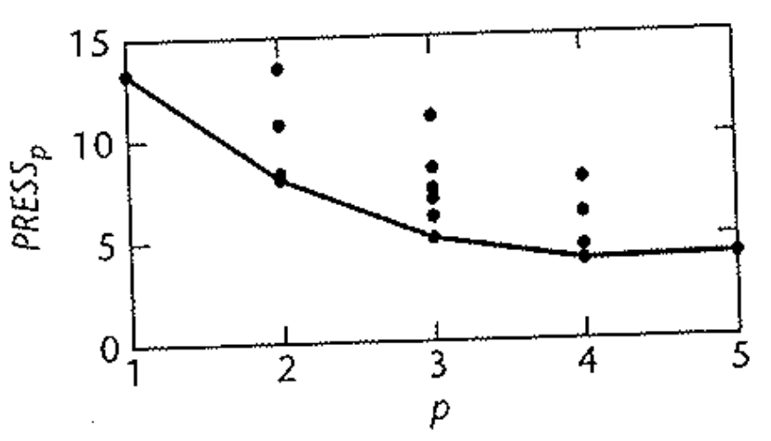
Model Selection
Below is the table with the PRESS_{p} values for all possible regression models as well as the plot against p. As with the other criterion, the models with (X₁,X₂,X₃) and (X₂,X₃,X₄) do well with this criterion.

Slide 19
Model Selection
When selecting a set of predictor variables, typically an automated search procedure that sequentially produces the “best” set of predictors is used.
The forward stepwise procedure, which is the most commonly used, develops a sequence of regression models, at each step adding or deleting an X variable.
The criterion for adding or deleting an X variable can be stated equivalently in terms of error sums of squares reduction, coefficient of partial correlation, the t statistic, the F statistic, or the p-value.

Slide 20
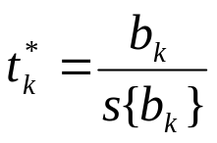
Model Selection
We will describe a stepwise regression search algorithm in terms of the t statistic and its associated p-value for the usual tests of regression parameters.
The routine first fits a simple linear regression model for each of the P-1 potential predictor variables with each variable the only predictor variable in it’s corresponding model. So P-1 simple linear regression models are fit.
For each simple linear regression model, the t statistic for testing whether or not the regression parameter is 0 is obtained, which for the k^{th} predictor is

Slide 21
Model Selection
The predictor with the smallest p-value (largest t value) is the candidate for the first addition.
If the corresponding p-value is less than a predetermined level for entry, the predictor is added.
Otherwise, the routine stops with no predictors considered sufficiently helpful to enter the model.
2) Assume that X₇ is entered into the model in step 1. The routine next fits models with two predictors, where each of the remaining X_{k} is paired with X₇ .

Slide 22
Model Selection
For each of these models, the t statistic corresponding to the newly added X_{k} is obtained.
This is the statistic for testing whether β_{k} = 0 given that X₇ is in the model. The X variable with the smallest p-value is the next candidate for addition into the model.
If the corresponding p-value is less than the pre-determined level for entry, the predictor is added, other wise the routine stops.
3) Suppose X₃ is added at the second stage. Next the routine examines whether any of the X variables already in the model should be dropped.

Slide 23
Model Selection
For our example, the only other predictor in the model is X₇, so only the t statistic corresponding to testing X₇ given that X₃ is in the model is obtained.
At later stages, t statistics would be obtained for each predictor that was already in the model when the latest one was added.
The predictor variable which has the largest p-value is a candidate to be dropped from the model. If the corresponding p-value is larger than a pre-determined level for removal, the predictor is deleted, other wise it is retained.

Slide 24
Model Selection
4) Suppose that X₇ is retained such that X₃ and X₇ are both in the model.
The routine next examines if any other variables should be added, and if so, examines if any of the variables already in the model should be deleted.
This process continues until no further X variables can be added or deleted from the model.
Note, the algorithm allows for an X variable, brought into the model at an earlier stage, to be dropped subsequently if it is no longer helpful in conjunction with variables added at later stages.
SAS - stepwise

